Slide 1
Older Children's Facilities Working Group

Slide 2
Working Group Members
John Harrison
Joe Gray
Patrick Dodgson
Jim Slater
Katrina Harrison
Ellie Rogers

Slide 3
Steps
Where could facilities identified in step 1 be sited?
What could be the likely Planning Restrictions?
Where could funding be obtained?
What are the likely costs?
What Do Older Children Want?

Slide 4
Step 1
What Do Older Children Want?

Slide 5
5 MOST POPULAR PLAY IDEAS for
7 to 16 YEAR OLDS in HADNALL

Slide 6
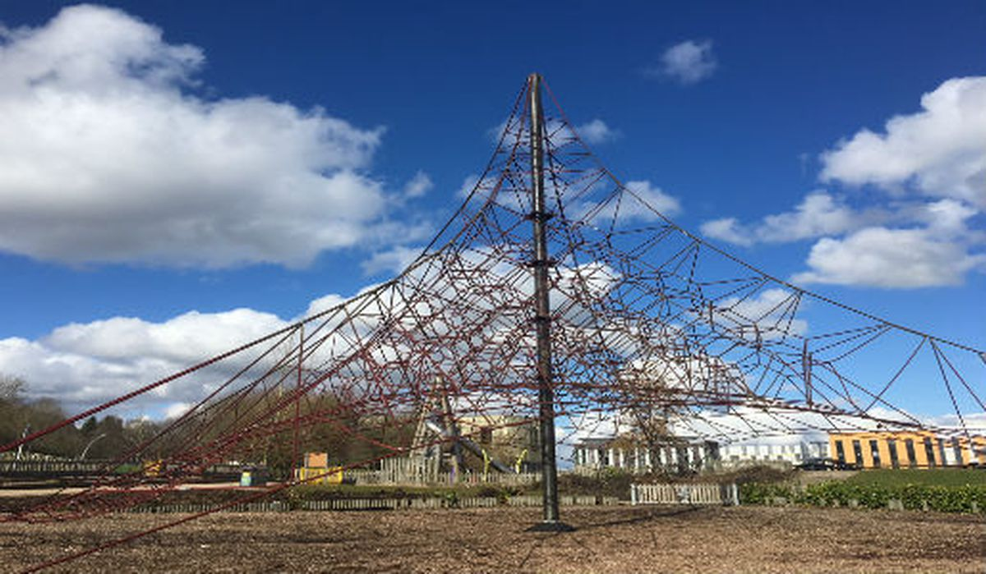
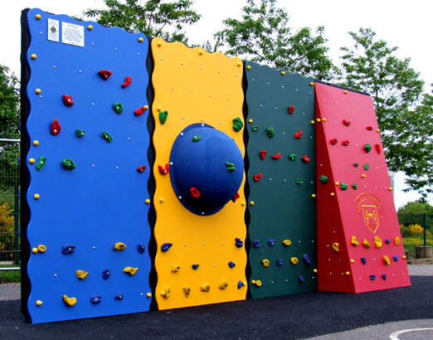
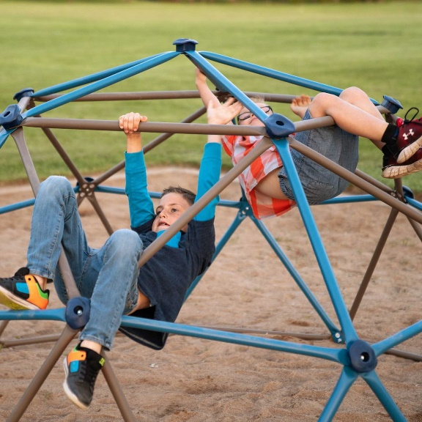
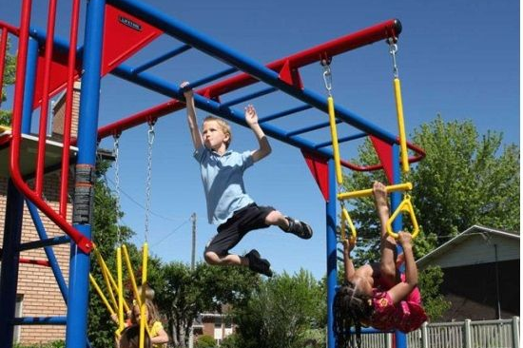
1. Older Children wanted…TO CLIMB!
The most popular was a spider web pyramid-type frame.
Other popular options included:
(rock) climbing wall
frame to climb on
monkey bars

Slide 7
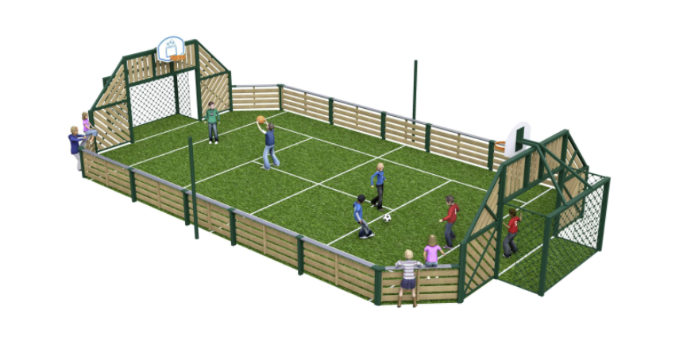
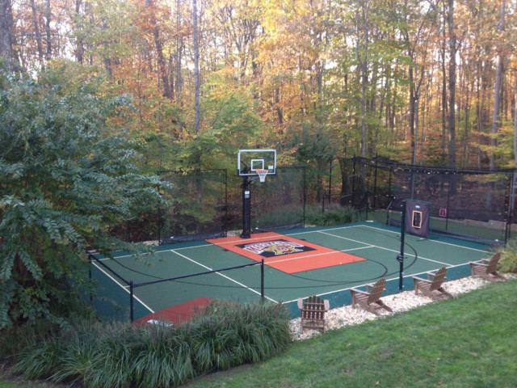
2. Older Children wanted a ….COURT TO PLAY SPORTS!
The most popular was an all weather facility to play football basket ball, and other ball games.

Slide 8
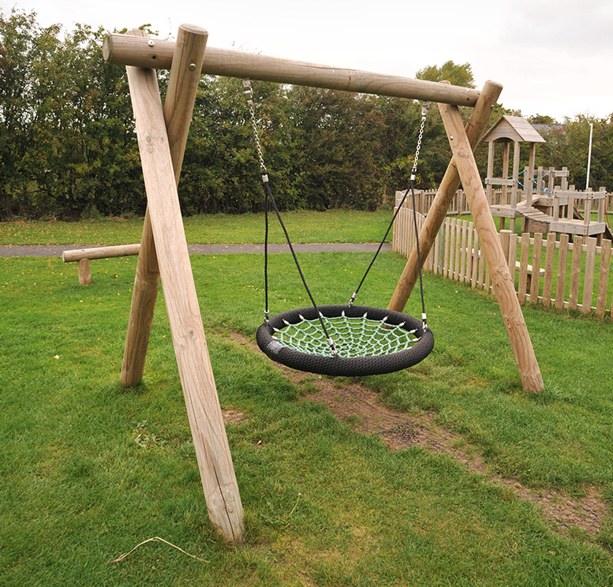
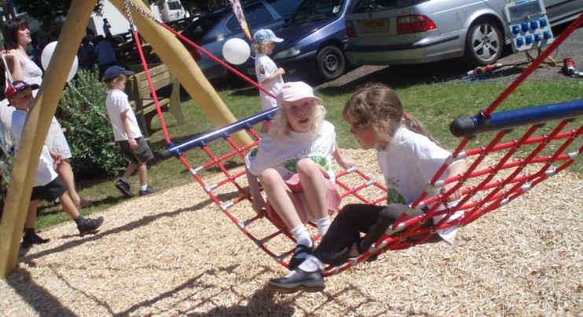
3. Older Children wanted… MORE SWINGS!
The most popular being a ‘spider type swing’

Slide 9
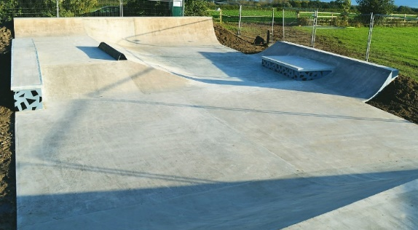
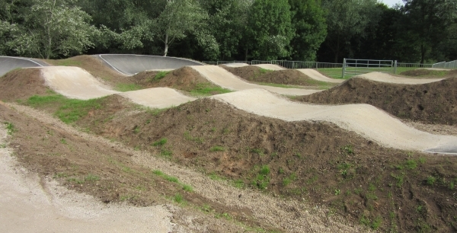
4. Older children wanted…A TRACK/TRAIL/PARK FOR BIKING, SCOOTING, SKATE BOARDING/ROLLER SKATING/GO KARTING ON!
Partly with jumps and stunts and partly without to appeal to all abilities.

Slide 10
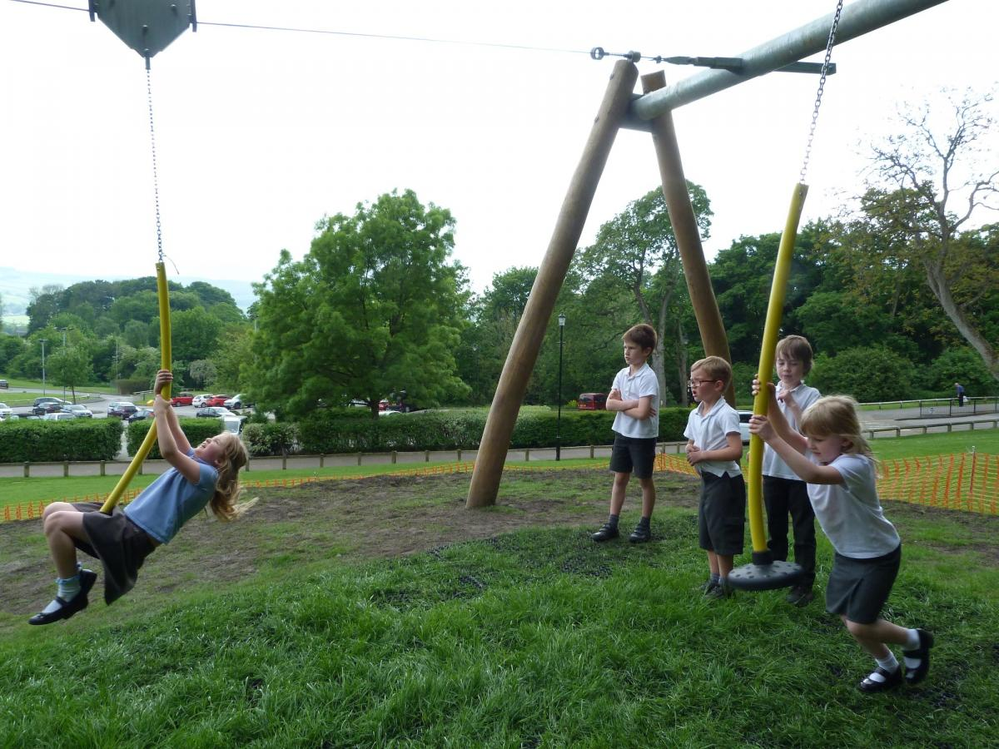
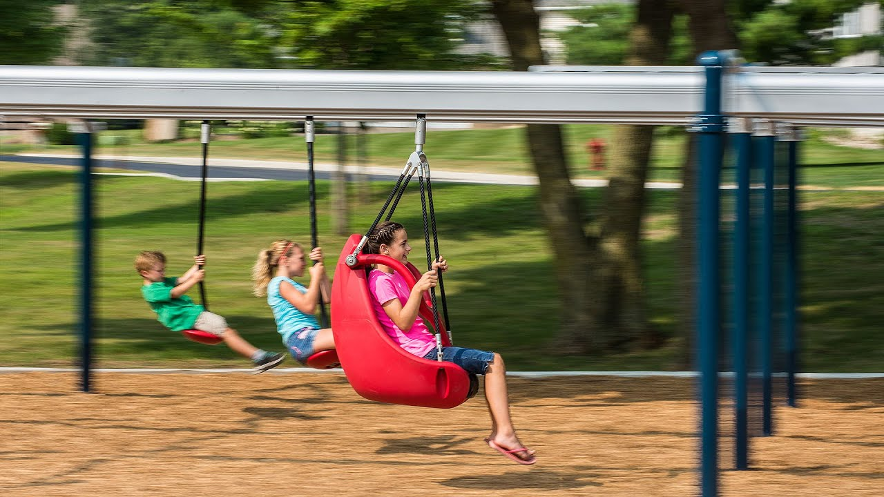
5. Older children wanted…A ZIP WIRE!

Slide 11
Steps
What Do Older Children Want?
What are the likely costs?
Where could funding be obtained?
What could be the likely Planning Restrictions?
Where could facilities identified in step 1 be sited?

Slide 12
Step 2
What are the likely costs?

Slide 13
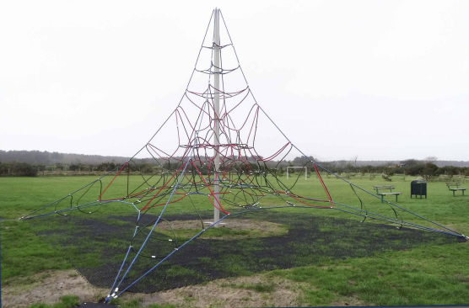
Estimated Costings ££££
Spider Webs – 4m – 8m 15k -25k

Slide 14
Estimated Costings ££££
Multi Use Games Area – 40k - 80k
20m x 12m – 30m x 15m

Slide 15
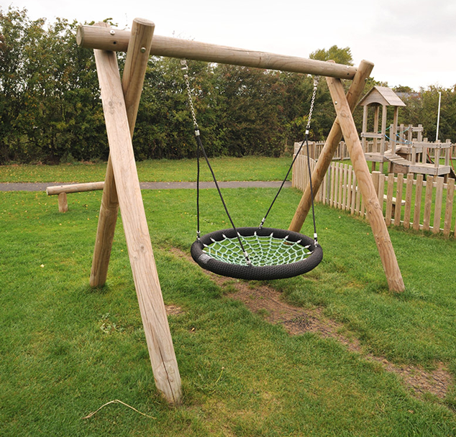
Estimated Costings ££££
Single Point Swing – 12k – 15k

Slide 16
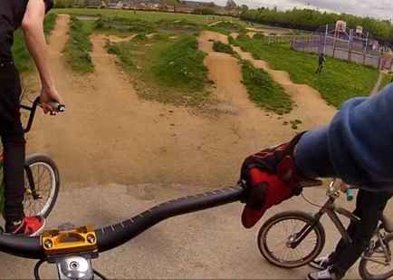
Estimated Costings ££££
Bike Track – Not costed

Slide 17
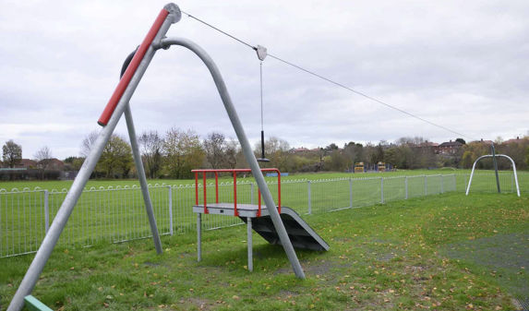
Estimated Costings ££££
Zip Wire – 15k – 20k

Slide 18
Steps
What Do Older Children Want?
What are the likely costs?
Where could funding be obtained?
What could be the likely Planning Restrictions?
Where could facilities identified in step 1 be sited?

Slide 19
Steps
Where could funding be obtained?

Slide 20
Funding Options

Slide 21
Steps
What Do Older Children Want?
What are the likely costs?
Where could funding be obtained?
What could be the likely Planning Restrictions?
Where could facilities identified in step 1 be sited?

Slide 22
Steps
What could be the likely Planning Restrictions?

Slide 23
Steps
What Do Older Children Want?
What are the likely costs?
Where could funding be obtained?
What could be the likely Planning Restrictions?
Where could facilities identified in step 1 be sited?

Slide 24
Steps
Where could facilities identified in step 1 be sited?

Slide 25
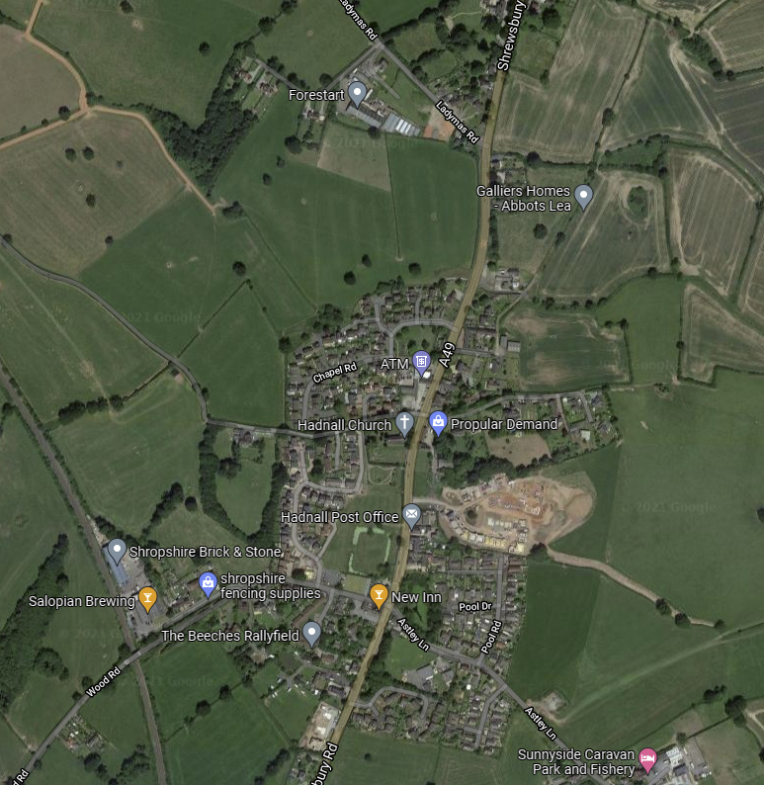
The Working Group identified 11 Potential sites in total
8 Owned Privately
7 Not available
1 potentially available subject to further negotiation

Slide 26
The Working Group identified 11 Potential sites in total
8 Owned Privately
7 Not available
1 potentially available subject to further negotiation

Slide 27
The Working Group identified 11 Potential sites in total
7 Owned Privately and Not Available
Further 3 sites on land owned by village

Slide 28
Older Children's Facilities Working Group
What Do Older Children Want?
What are the likely costs?
Where could funding be obtained?
What could be the likely Planning Restrictions?
Where could facilities identified in step 1 be sited?

Slide 29
Option 1
Commission the installation of a 4/6m Spider Web and /or a web swing on the village Green
Overall Cost 30 – 40k

Slide 30
Option 2
Commission the installation of Multi Use Games Area on the village Green
Overall Cost 40 – 80k (depending on size and specification)

Slide 31
Option 3
Commission the installation of Multi Use Games Area on the Ease
Overall Cost 40 – 80k (depending on size and specification)

Slide 32
Option 4
Explore in conjunction with Sansaw estate the installation of Multi Use Games Area on the area of ground to the South of the Ease
Overall Cost 40 – 80k (depending on size and specification)

Slide 33
Option 5
Do nothing until the next round of development within the village (predicted to come as part of Shropshire Councils Local Plan Review 2016– 2038)
Overall Cost Potentially Zero

Slide 34
Recommendation
The Older Children's Facilities Working Group recommend that HPC consider the implementation of option 4.
This recommendation could be part funded by ring fencing some or all of the Neighbourhood funds currently held by HPC.
In implementing this recommendation the council should seek to:
Explore fully options to help with any shortfall in funding
Carry out a full and robust consultation with local parishioners on its planned proposals.
Work closely with Sansaw estate to explore viability of site
In conjunction with the above, where funds allow, the implementation of either element of option 1 might be considered on the village green or as part of any future development.

Slide 35
Older Children's Facilities Working Group

